Slide 1
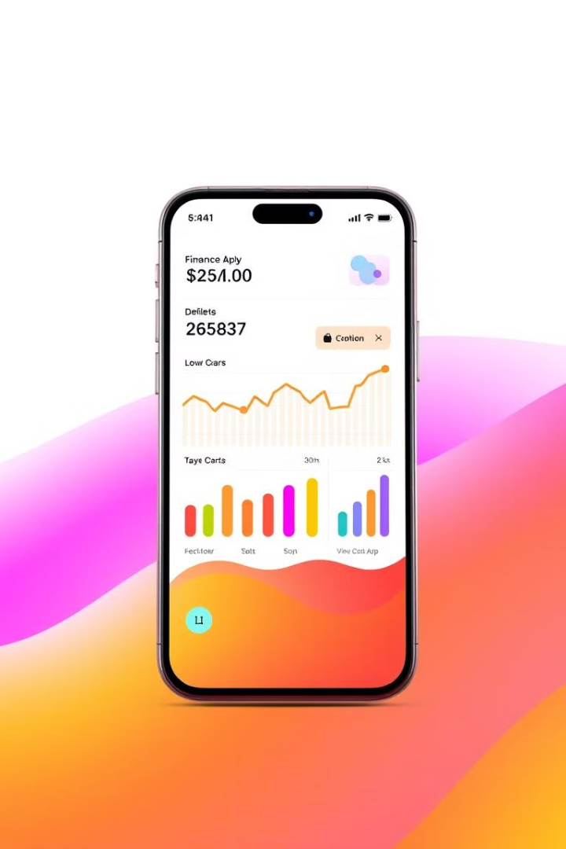
My KhataBook: A Budget Manager
This presentation explores the design and implementation of an Expense Tracker application built using Python, Tkinter for the user interface, SQLite for data storage, and Matplotlib for visualization.

Slide 2
Introduction to the Project
Purpose
Target Audience
The Budget and Expense tracker is a personal finance management tool designed to help individuals efficiently track and analyze their spending habits.
The application caters to individuals seeking a simple yet effective way to manage their finances, with a focus on intuitive user interface and data-driven insights.

Slide 3
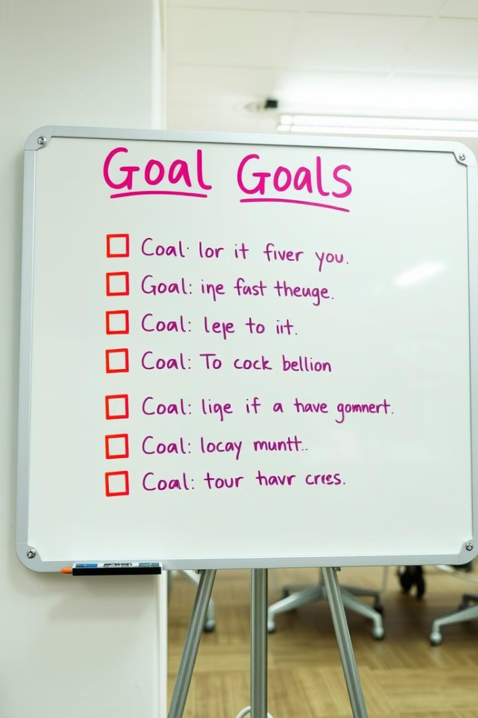
Objectives and Goals
1
Objective 1
2
Objective 2
Develop a user-friendly and interactive expense tracker application.
Implement a robust database to store and manage user expense data efficiently.
3
Objective 3
Enable users to visualize their spending patterns through insightful charts and graphs.

Slide 4

Literature Review: 3 Related Papers
Paper 1
Paper 2
Title: "Personal Finance Management: A Review of Technology-Based Solutions" Author: Smith, J. (2023)
Title: "The Impact of Mobile Financial Apps on Personal Budgeting Behavior" Author: Jones, A. (2022)
Paper 3
Title: "Data Visualization Techniques for Personal Finance Insights" Author: Williams, B. (2021)

Slide 5

Problem Statement
Many individuals struggle with managing their finances effectively, often lacking organized methods for tracking expenses and gaining insights into spending patterns.

Slide 6
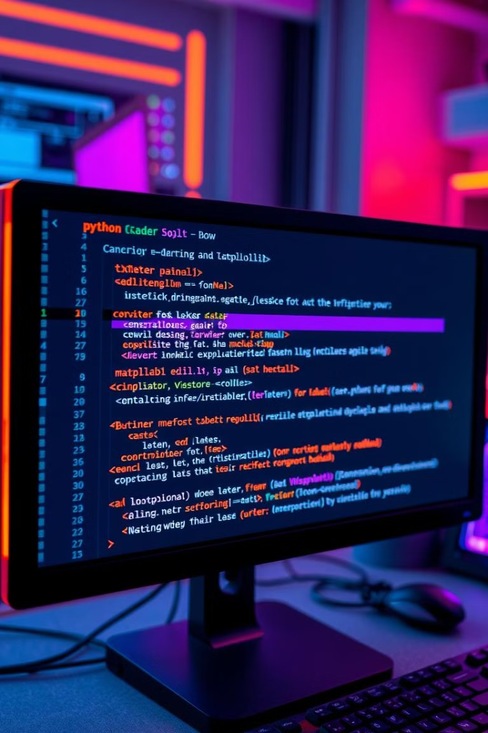



Solution Approach
Python
Python's versatility and extensive libraries made it the ideal choice for building the application's core functionality.
SQLite
SQLite was chosen as the database system for its ease of use, portability, and efficiency in handling user expense data.
Matplotlib
Matplotlib's data visualization capabilities enabled the development of insightful charts and graphs to analyze spending patterns.

Slide 7
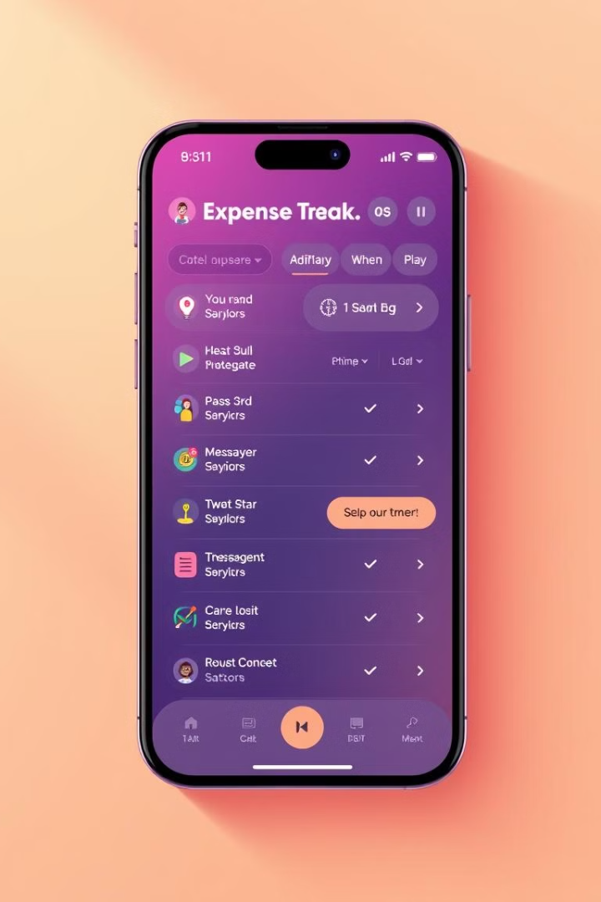
User Interface and Features
1
Add Expense
Users can easily add expenses by specifying the date, category, and amount.
2
View Expenses
The application provides a clear view of all recorded expenses, organized by date or category.
3
Generate Reports
Users can generate reports to analyze spending patterns, view monthly summaries, and track progress towards financial goals.

Slide 8




Database Design and Operations
Data Storage
Data Retrieval
Data Updates
The SQLite database stores user expense data in a structured manner, with tables for expenses, categories, and user information.
The application utilizes SQL queries to retrieve specific expense data based on user input or predefined criteria.
The database allows for efficient updates and modifications to expense records as needed.

Slide 9
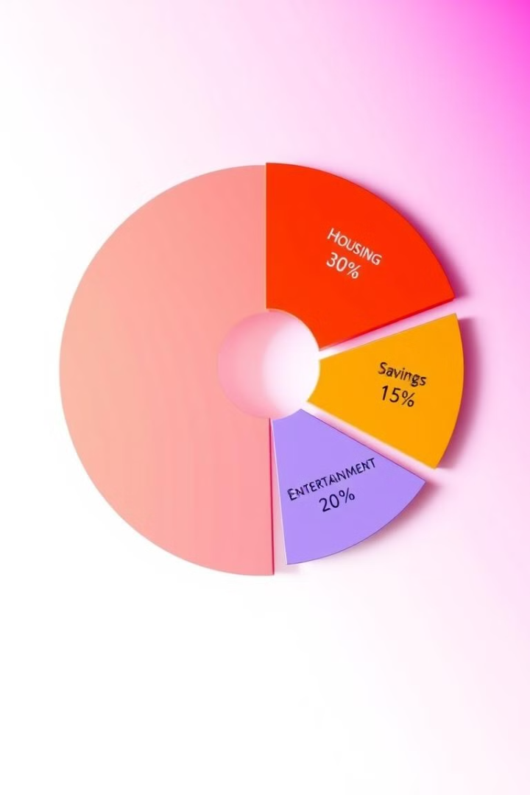
Data Visualization and Analysis
50%
Category Analysis
Pie charts provide a visual representation of the percentage of spending allocated to different expense categories.
25%
Time Trends
Line graphs illustrate spending trends over time, revealing patterns and potential areas for improvement.
25%
Budgeting Insights
Bar charts compare actual spending against budgeted amounts, providing insights into financial management effectiveness.

Slide 10
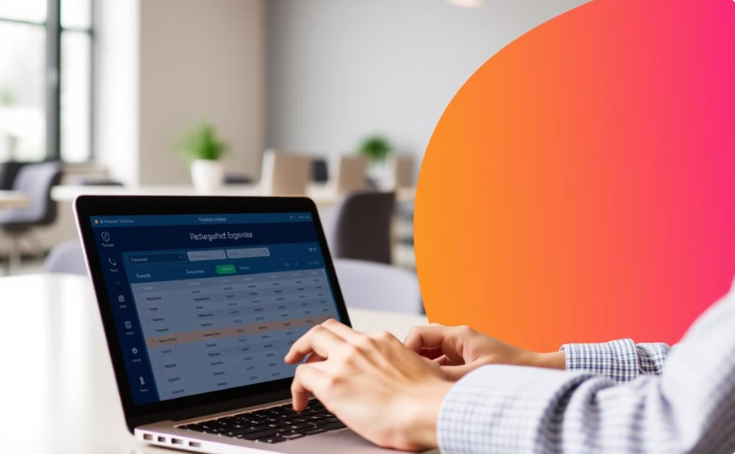

Real-World Applications and Use Cases
Personal Finance
Business Expenses
Individuals can track their daily spending, identify areas of overspending, and make informed decisions about their finances.
Businesses can utilize the Expense Tracker to track employee expenses, monitor spending patterns, and make informed financial decisions.

Slide 11
THANK YOU

